Slide 1
Human Benchmark VR
Nikolas Koch and Mateo Curci

Slide 2
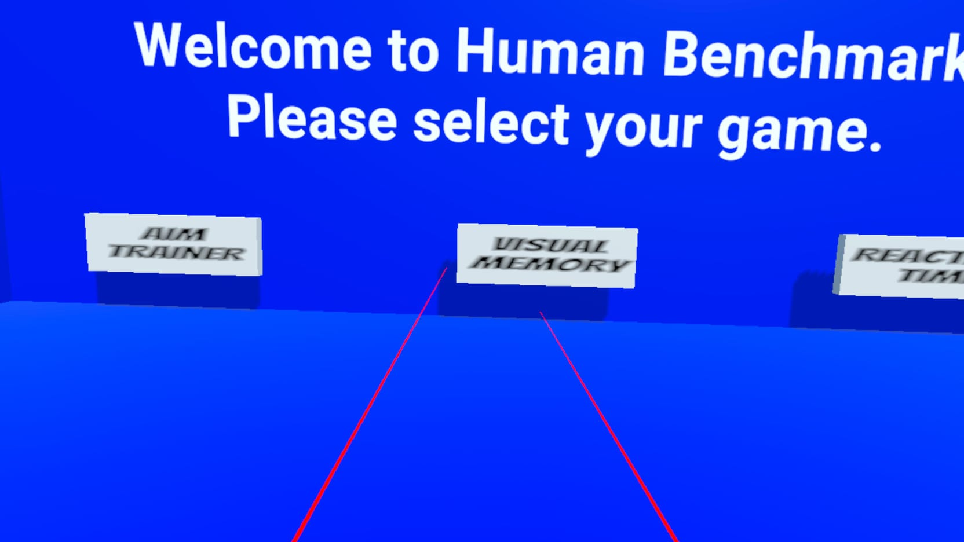
Main Lobby
This Scene has 3 buttons, one for each mini game.
The user clicks on whichever game they want to play.
Once clicked, it transports them to the corresponding scene.

Slide 3
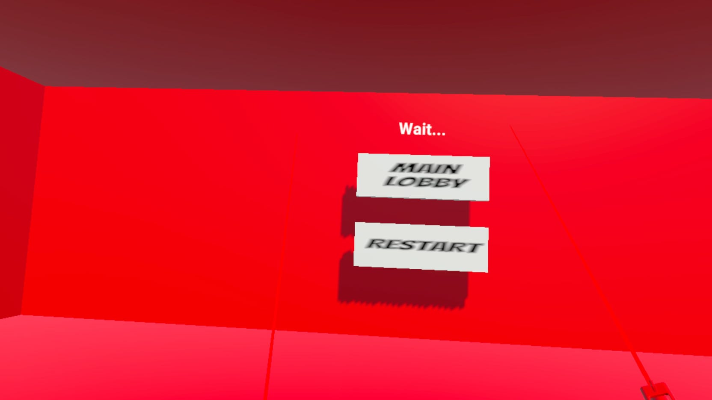
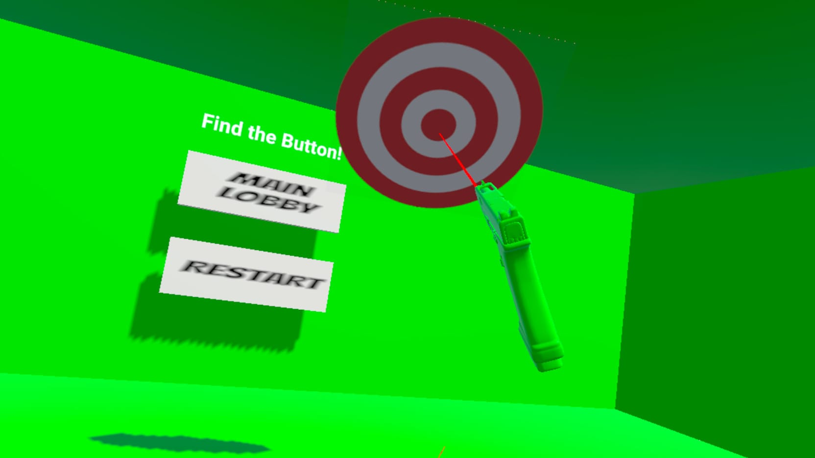
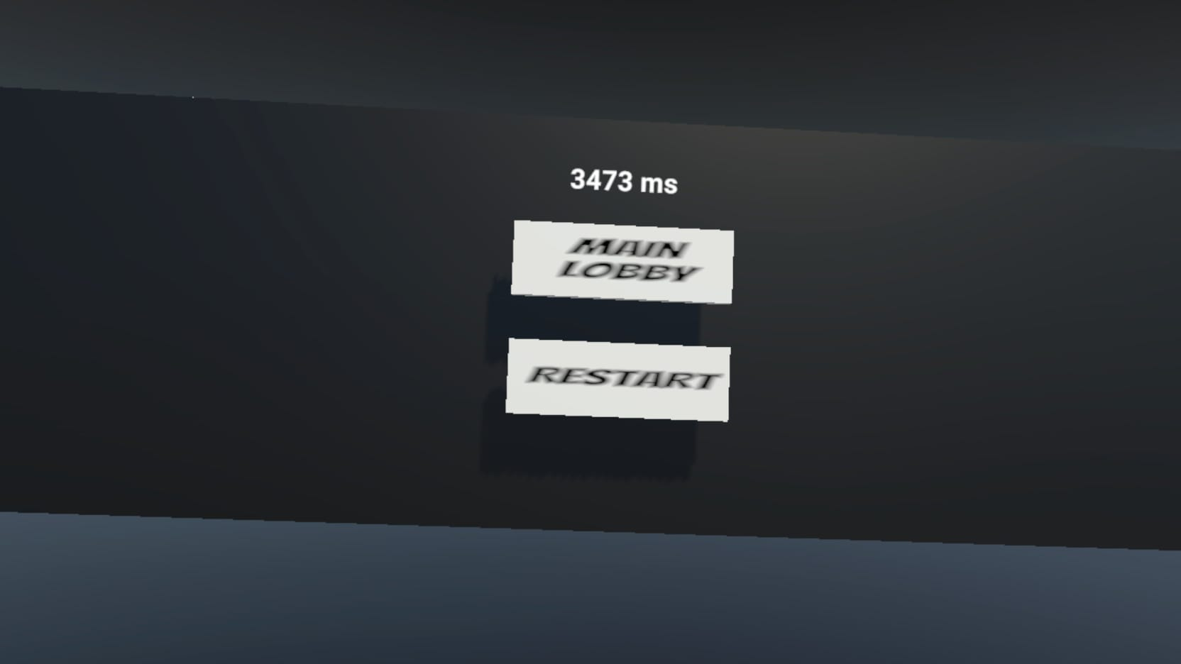
Reaction Time
User spawns in a red room
Room turns green and a target spawns after a random 2-5 second delay
User has to find the target anywhere in a 360-degree radius.
Once clicked, the time is displayed in front of the user
User can restart the game or go back to the main lobby.

Slide 4
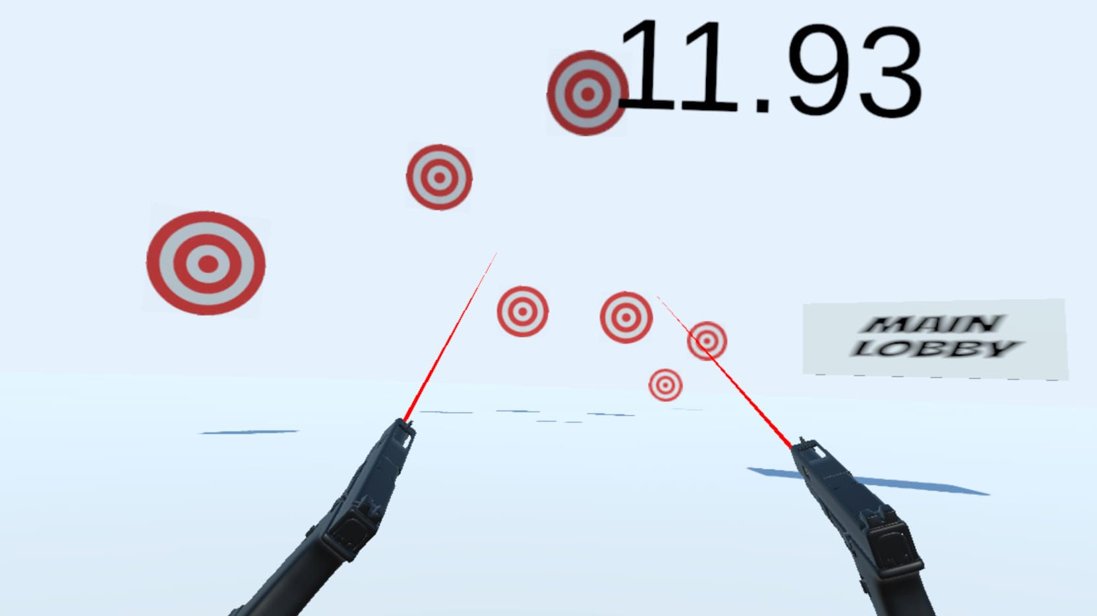
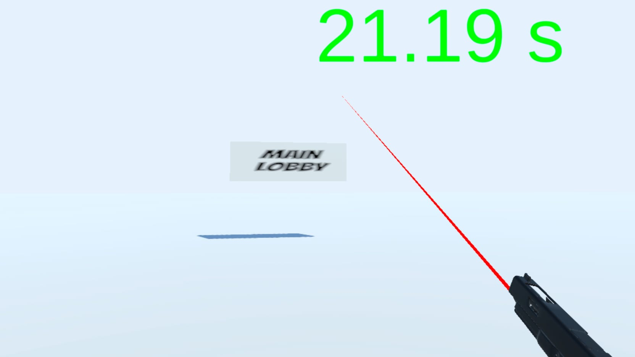
Aim Trainer
20 targets spawn around the player
Timer starts
Once all targets are destroyed, timer stops.
After 5 second delay the game restarts
You can go back to main lobby as well.

Slide 5
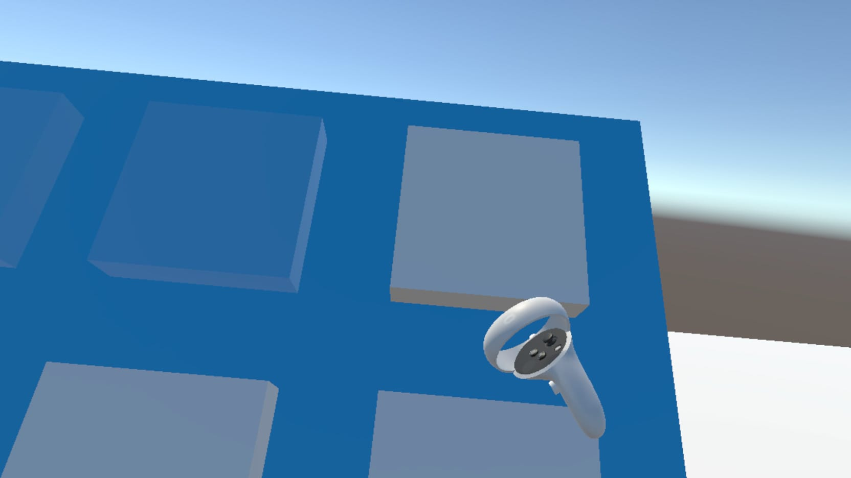
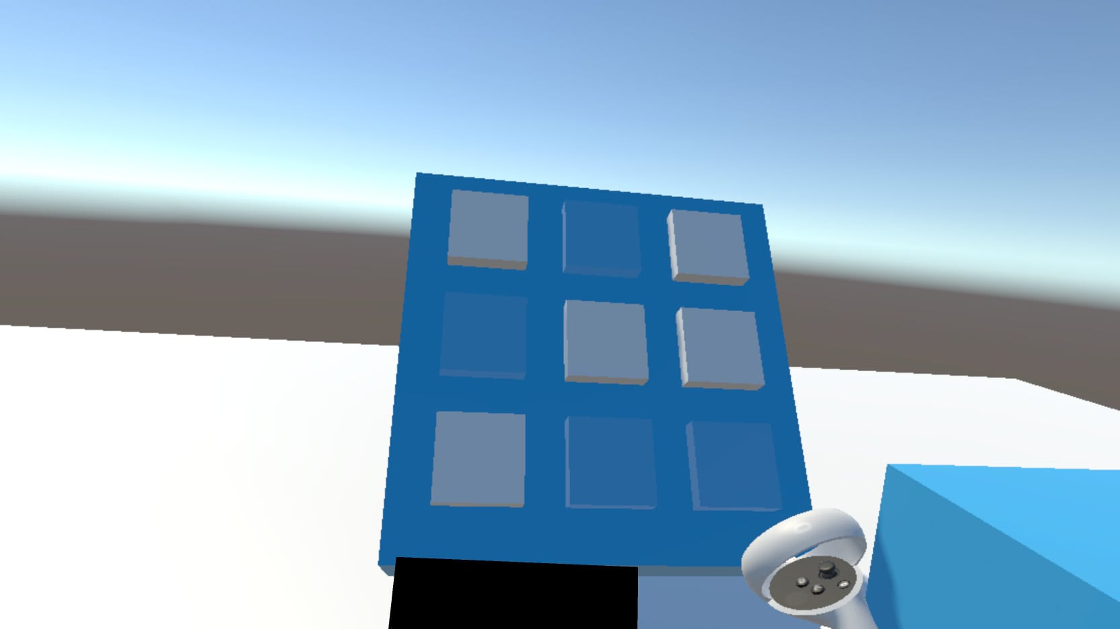
Visual Memory
User spawns facing a 3 x 3 board.
A sequence of squares are lit up.
The user has to memorize the exact order and place 3D cubes in the correct spots
If user makes a mistake, the entire game restarts.
Once the user passes the test, it goes back to main lobby after a 5 second delay.

Slide 6
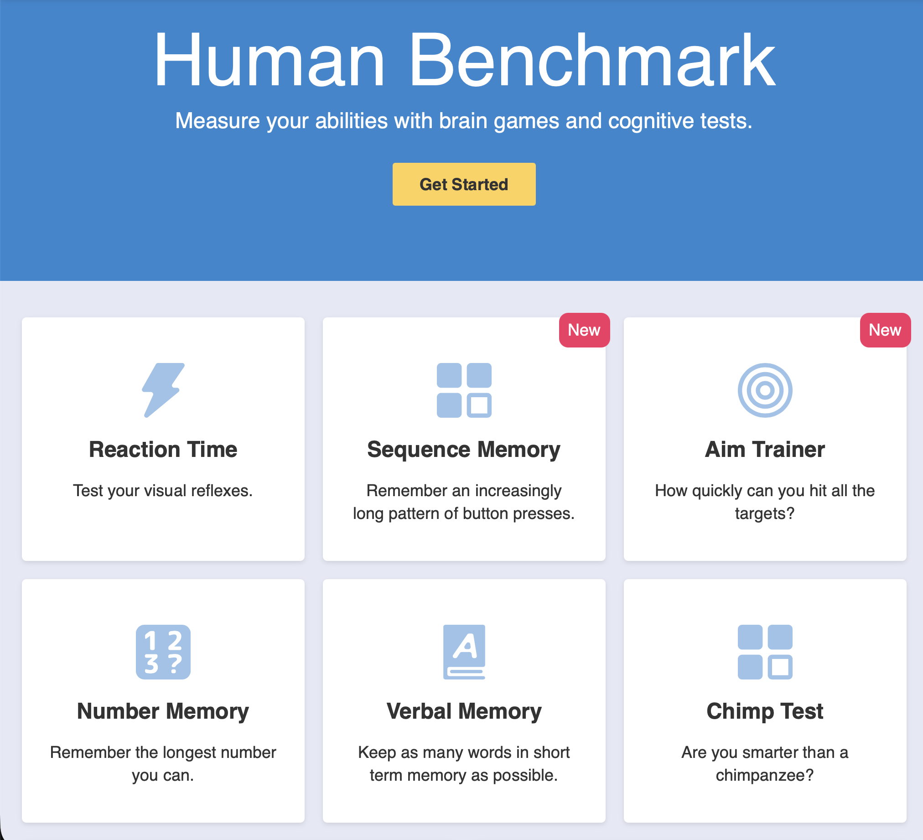
Reference Game
Our reference game is Human Benchmark.
A 2D website where users can see where they rank on common benchmarks such as visual memory tests and reaction time.
https://humanbenchmark.com/

Slide 7
Issues we ran into
Our main issue was incorporating clicking with the controllers.
Another issue in the reaction time is the script would spawn the target outside of the room, or right on top of the player so it would be invisible to the player.
In the Aim Trainer some targets spawn behind to “back to Lobby” Button

Slide 8
Team Member Assignments
Nikolas Koch:
Visual Memory
Aim Trainer
Mateo Curci:
Main Lobby
Reaction Time

